Slide 1
Thunderstorms
Y.K. REDDY
Scientist ‘F’ (Instruments)
Meteorological Center,
HYDERABAD.

Slide 2
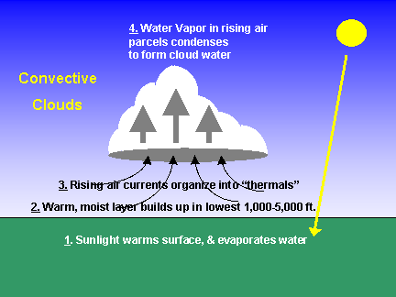
THUNDERSTORM
Most common type of storm that occurs over the earth, particularly in the tropics.
Several thousand occur in the course of a day.
Practically unknown in the polar region.
Rapidly rising warm moist currents, when aided by a favorable lapse rate in the atmosphere (instability), develop into cumulonimbus clouds which produce the storm.
For the purpose of reporting a thunderstorm, there is a convention that thunder should be heard.

Slide 3
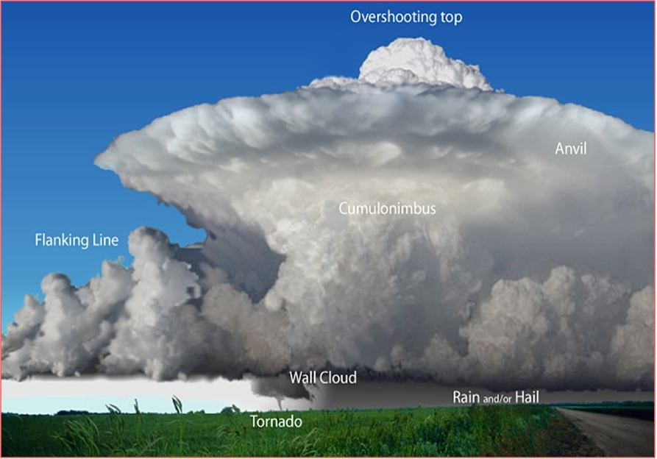
Cumulonimbus (Cb) Cloud

Slide 4
CONDITIONS FAVOURABLE FOR THUNDERSTORMS
Adequate supply of moisture at low levels.
A deep unstable layer (having a lapse rate more than S.A.L.R.) in the atmosphere to facilitate rise of warm humid- air up to great heights
Trigger action to set off the rapid convection process.
Trigger action means the initial process of lifting up a quantity of air from surface level. This is usually provided by
insolation (Cb clouds will be scattered and are frequent towards afternoon/ evening.
convergence due to low pressure systems like Depressions, Cyclones (Cb clouds widespread and may occur at any time of the day or night)
ascent of air along a frontal surface
ascent of air over rising ground (hill slopes).

Slide 5
LIFE CYCLE OF A THUNDERSTORMS
The life of a thunderstorm is about an hour or two
Three stages.
The first stage, developing or cumulus stage, when only up currents are present in the cloud; the up currents are strongest in the upper part of the cloud.
The second stage, the mature stage when the cloud develops to the maximum height. The cloud consists of both up and down currents. Precipitation reaches ground and may be heavy. Lightning is most frequent at this stage.
The final stage, the dissipating stage when the cloud consists of only weak down currents. Precipitation at ground becomes light. The lower portions of cloud dissolve first but the anvil (top most part) persists for sometime eventually becoming cirrus and cirrostratus.

Slide 6
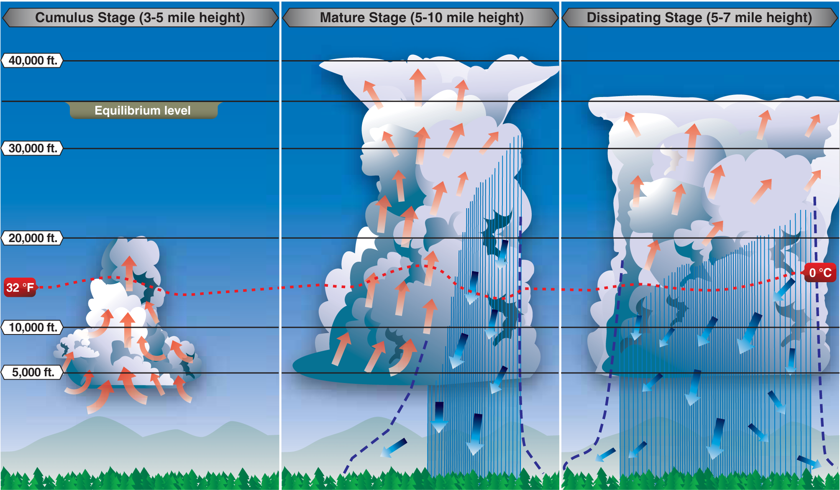
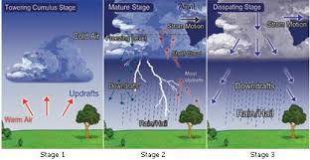

Slide 7
THUNDERSTORM WEATHER
When precipitation starts within a thundercloud, the falling water drops initiate a downdraft.
The cooler downdraft descends to ground and spreads out horizontally over the ground, known as squall.
When the Cb cloud is moving, the spreading of this cold air takes place in that direction of the cloud.
For the purpose of reporting, a squall is taken as a sudden increase in wind speed with or without change in direction.
Very often thunderstorms are associated with a series of squalls.
The wind speed in the squalls often reaches 100 km/hr. particularly in summer resulting in uprooting of trees, damage to, Kutcha houses and to life.

Slide 8
LIGHTNING
Discharge of static electricity.
A lightning flash is an enormous spark.
The discharge may take place either between a cloud and the ground or within a two parts of a cloud or between two clouds.
At night, can be seen upto about 150 Kms.

Slide 9
THUNDER
Sound produced by the violent expansion of the air
Air is Suddenly and intensely heated along the path of the lightning flash.
The rumbling is caused by differences in the times required for sound to reach the observer's ear from various parts of a flash which is sometimes 2 kms long.
There is always a time lag between lightning and its accompanying thunder. Speed of Light 3 lakh Km/s; Speed of sound 0.34 Km/s; 9 lakh times faster).
Can be heard usually upto 8 to 16 kms

Slide 10
TORNADO
Also called "twisters”, The most violent weather phenomena known on the earth
They are an off shoot of some of the very severe thunderstorms.
A vortex of small horizontal extent and great intensity extending downward from a thundercloud.
It is usually visible as a funnel shape cloud with a broad base in the cumulonimbus and a narrow tubular extension tapering downward to the ground, few tens of metres .
The pressure within the centre of funnel cloud is very low, resulting in the production of very violent winds exceeding 200 kts around the centre.
Complete destruction when a tornado moves over a built up area.
Rare in India.
When tornado occurs over the sea, it is known as a water spout.

Slide 11
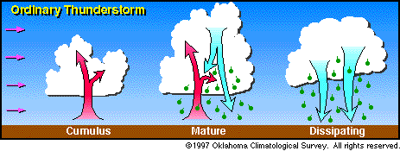
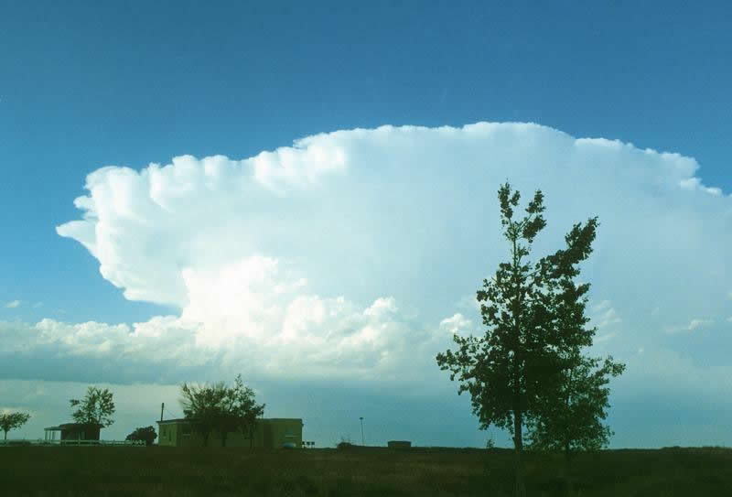
The whole process takes about one hour for an ordinary thunderstorm.
Supercell thunderstorms are much larger, more powerful, and last for several hours

Slide 12
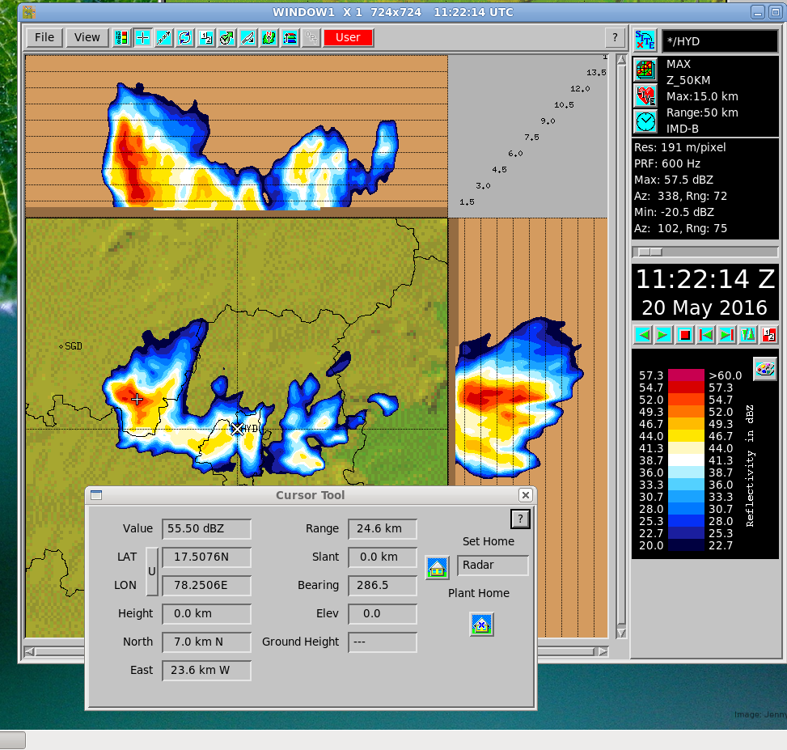
Radar Image of Thunderstorm Cloud (Maximum Reflectivity Image)
Patancheruvu (Lat 17.51 N 78.25 E)
Thunder storm clouds

Slide 13
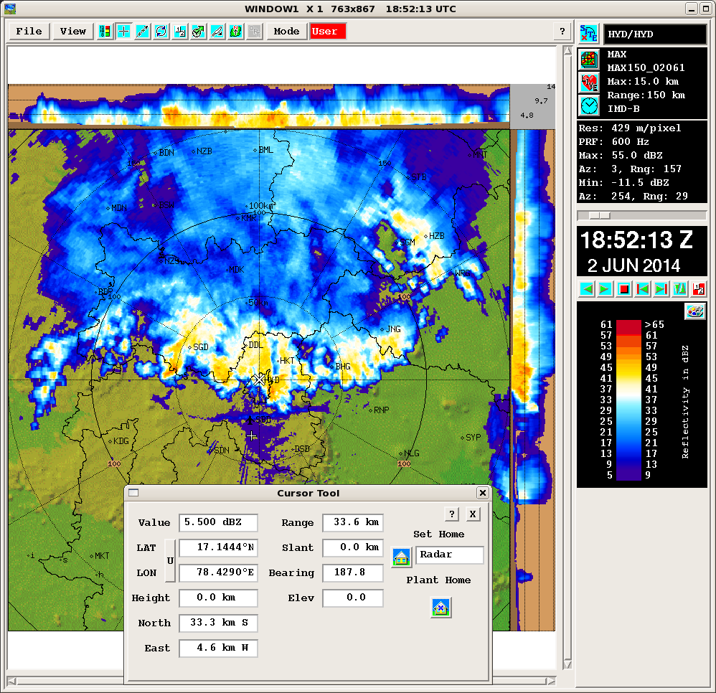
Radar Image of Thunderstorm Clouds, Squall Line (Maximum Reflectivity Image)

Slide 14
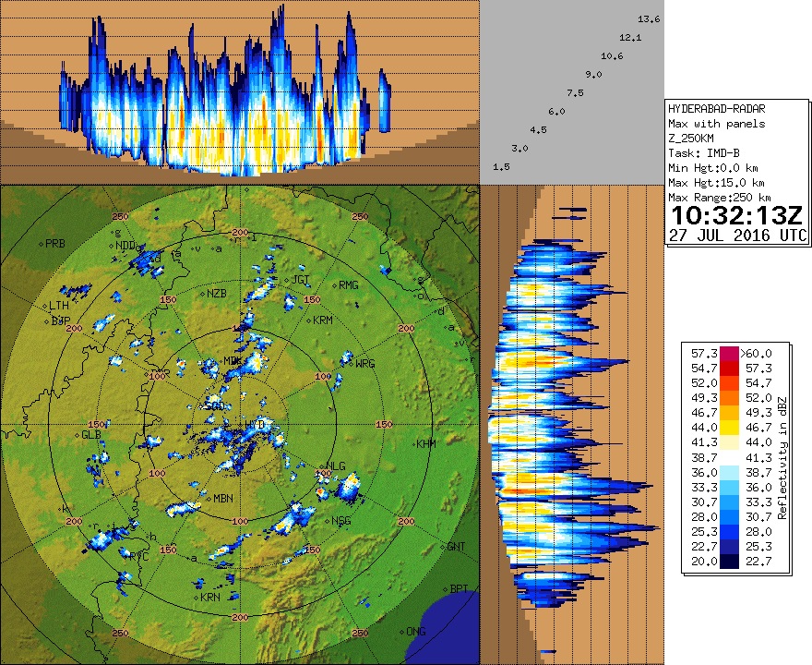
Radar Image of Thunderstorm Clouds, Scattred (Maximum Reflectivity Image)

Slide 15
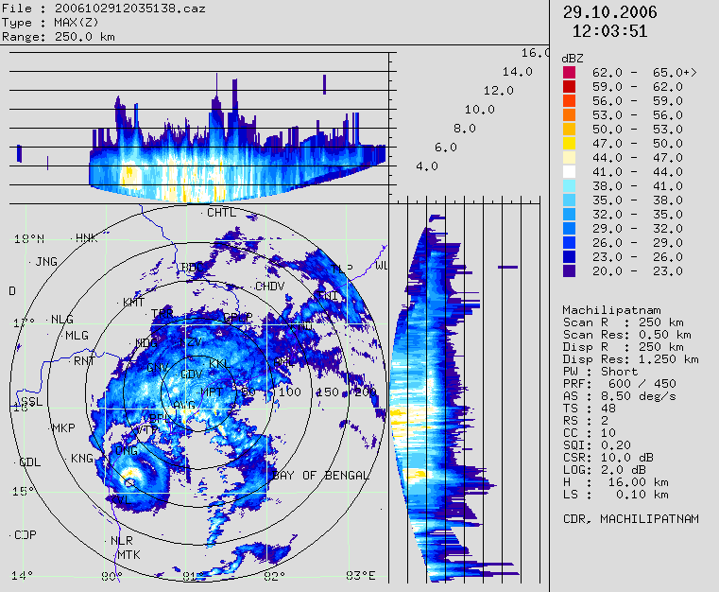
Radar Images of Thunderstorms : Cb in Cyclonic Storm

Slide 16
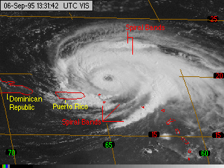
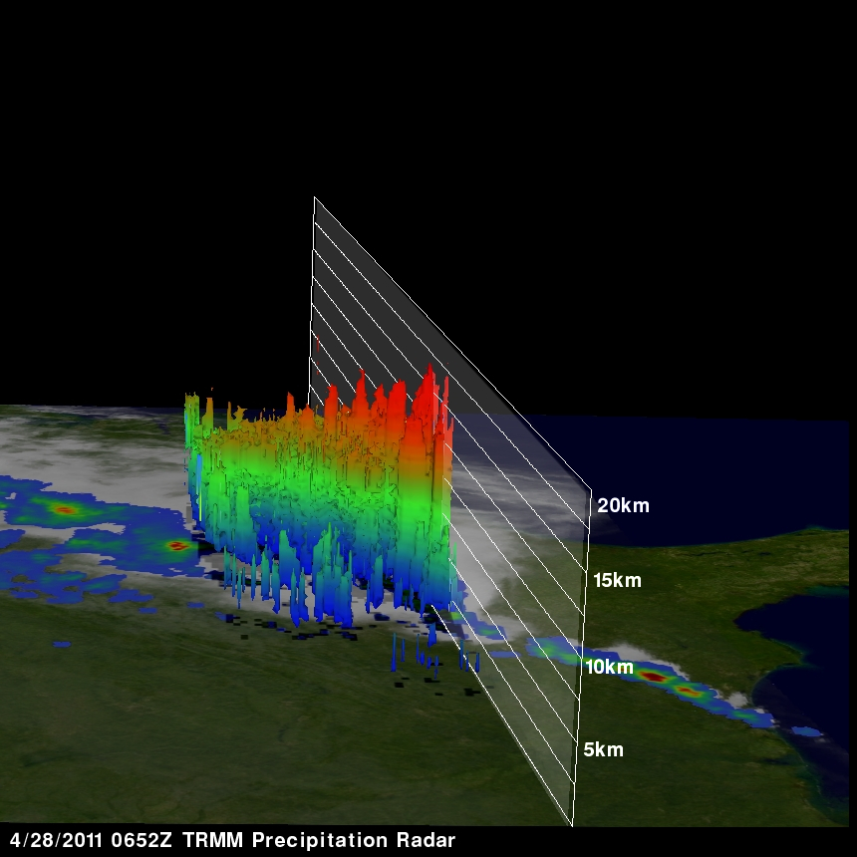
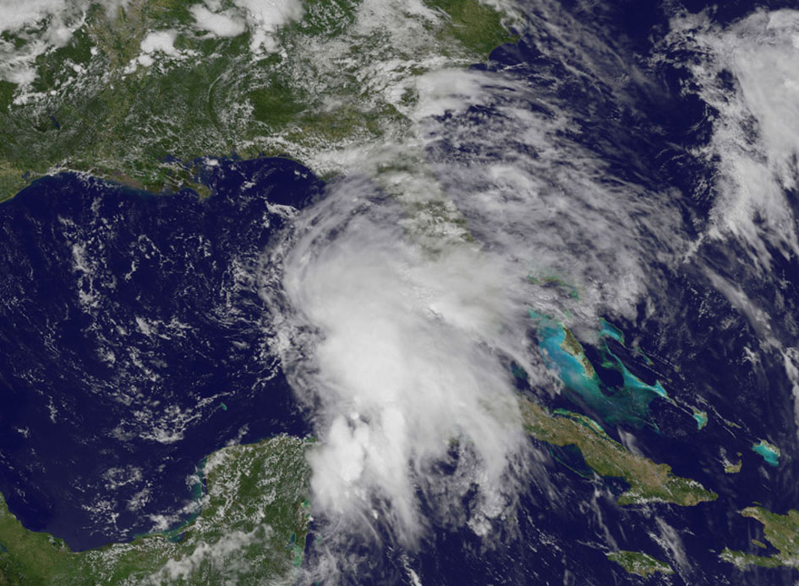
Satellite Images of Thunderstorms : Cb in Cyclonic Storm

Slide 17
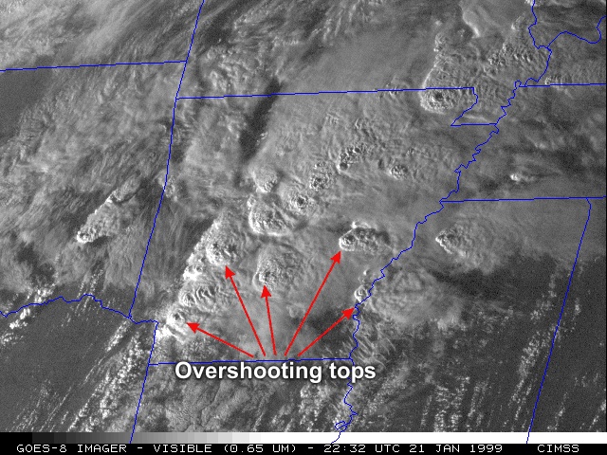
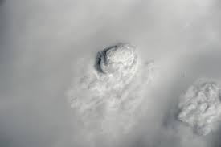
Satellite Images of Thunderstorms

Slide 18
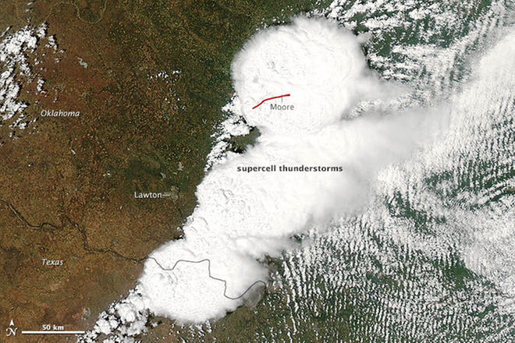
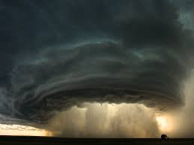
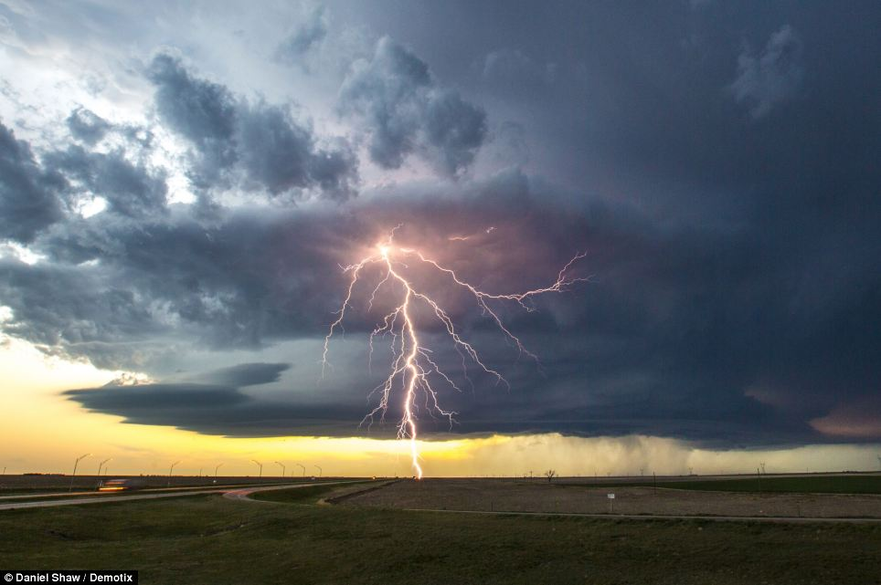
Satellite Images of Thunderstorms :
Supercell Thunder Storm
Supercells are a special type of thunderstorm. They last much longer than normal thunderstorms and produce the vast majority of tornadoes ...

Slide 19
Tracking Thunderstorms by
Weather Radar
By Weather Radar
B

Slide 20
Radar Images of Thunderstorms : Animations

Slide 21
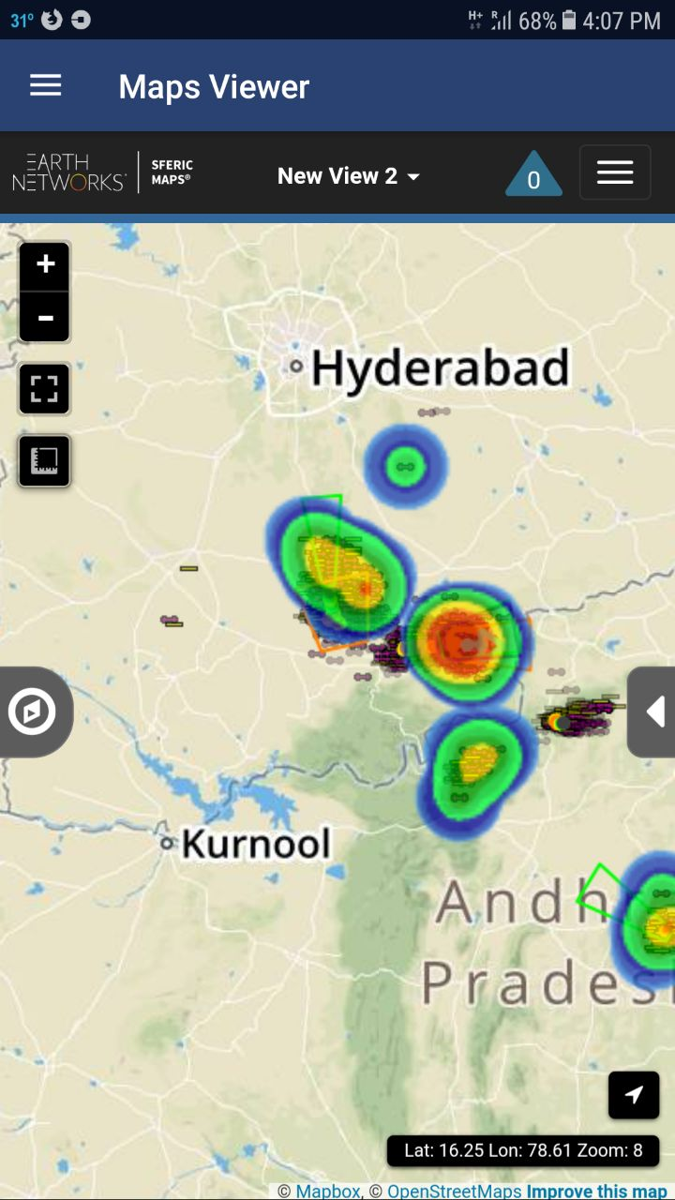
Lightning detection System by Earth Networks
Lighting hazard locations indicated on google map

Slide 22
Thank You

